Slide 1

Machine Learning Algorithms
(Multiple Linear Regression & Polynomial Regression)
Md. Abu Naser Mojumder

Slide 2
Well known Machine Learning Algorithms
Supervised Learning
Unsupervised Learning
Reinforcement Learning
Regression
Simple Linear Regression
Multiple Linear Regression
Polynomial Regression
Clustering
K-Means Clustering
Hierarchical Clustering
Upper Confidence Bound(UCB)
Thomson Sampling
Classification
Logistic Regression
k-Nearest Neighbors(k-NN)
Support Vector Machine(SVM)
Naïve Bayes
Decision Tree Classification
Random Forest Classification
Dimensionality Reduction
Principal Component Analysis(PCA)
Linear Discriminant Analysis (LDA)
Deep Learning Algorithm
Artificial Neural Network(ANN)
Convolutional Neural Network(CNN)

Slide 3
Multiple Linear Regression

Slide 4
Multiple Linear Regression
Multiple linear regression is used to estimate the relationship between two or more independent variables and one dependent variable.
You can use multiple linear regression when you want to know:
  How strong the relationship is between two or more independent variables and one dependent variable (e.g. how rainfall, temperature, and amount of fertilizer added affect crop growth)
  The value of the dependent variable at a certain value of the independent variables (e.g. the expected yield of a crop at certain levels of rainfall, temperature, and fertilizer addition).
Two Main Objectives of Multiple Linear Regression:
Establish if there is a relationship between two or more variables.
Forecast new observations.

Slide 5
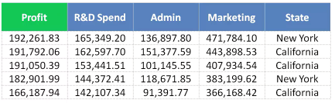
Multiple Linear Regression
The equation of Multiple Linear Regression:
bias term
$$y=b_{0}+b_{1}∗x_{1}+b_{2}∗x_{2}+..+b_{n}∗x_{n}$$
dependent variable
independent variable
y depends on multiple variables.

Slide 6
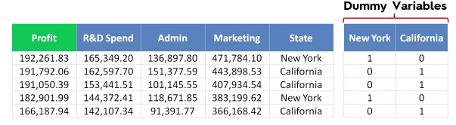
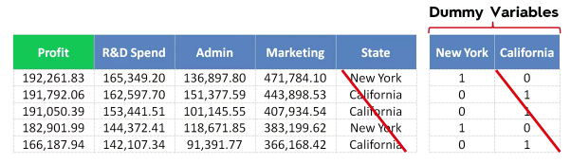
Multiple Linear Regression
Dummy Variable:
As we have one categorical variable (State), which cannot be directly applied to the model
$$y=b_{0}+b_{1}∗x_{1}+b_{2}∗x_{2}+b_{3}∗x_{3}+b_{4}∗D_{1}$$

Slide 7
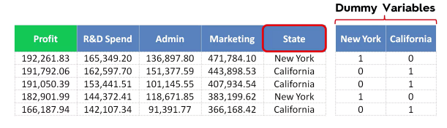

Multiple Linear Regression
Dummy Variable Trap:
Always omit one dummy variable. If we have 100 dummy variable we should keep 99 of them. Otherwise it will have a negative effect on the model.
Q. What is Dummy Variable trap? What will happen if we add all dummy variables?
Solution: https://youtu.be/5Q69P5r2u2A

Slide 8
Polynomial Regression

Slide 9
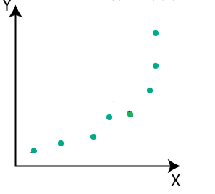
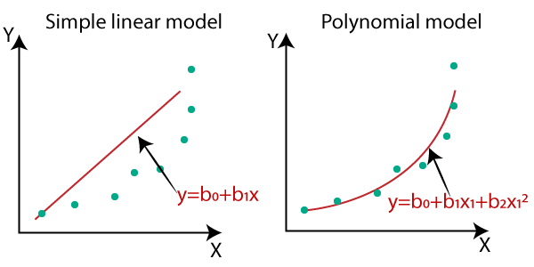
Polynomial Regression
The equation of Polynomial Regression:
$$y=b_{0}+b_{1}∗x_{1}+b_{2}∗x_{1}^{2}+..+b_{n}∗x_{1}^{n}$$

Slide 10
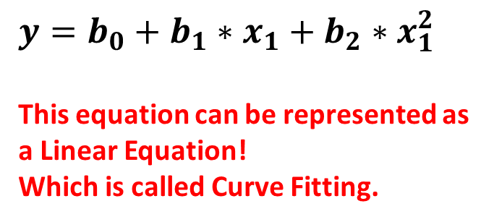
Polynomial Regression
Perfectly Fitted Line:
$$y=b_{0}+b_{1}∗x_{1}+b_{2}∗x_{1}^{2}$$
This equation can be represented as a Linear Equation!
Which is called Curve Fitting.
Q. The Polynomial Regression is also a Linear Regression! But why?

